Slide 1
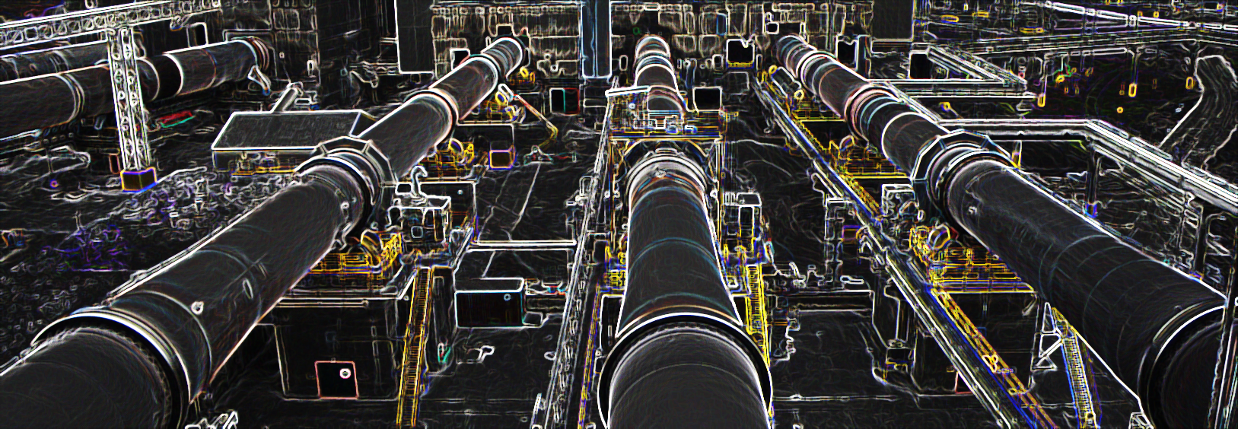
Combustion Engineering
Technical Development Program for Process Performance Engineers – SPREAD 2016
Mirko Weber

Slide 2
Learning Objectives
Know how to calculate the gas flows in a kiln system
Know what is contributing to the gas flows in a kiln system
Know how to check the amount of false air in a kiln system
2

Slide 3
Content
Basic Definitions
Gasflow Calculations
False Air Investigation
3

Slide 4
Gas flow is calculated in Nm³
Basic Definitions
Actual conditions (of gas flow)
actual absolute pressure (ambient + Δp: ~ 750-1030 mbar)
actual temperature (~ -20°C to 1500°C)
Normal conditions → Nm³
1013 mbar (ambient pressure at sea level)
273.15 K (water freezing temperature = 0°C)
Standard conditions (US) → scf (standard cubic foot)
30 inch Hg (1016 mbar)
60°F (15.6°C = 288.7 K)
4

Slide 5
Content
Basic Definitions
Gasflow Calculations
False Air Investigation
5

Slide 6
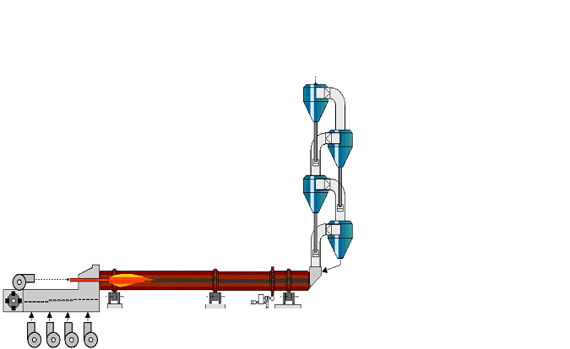
Mass flows in & out of the kiln system
Gasflow Calculations
Raw meal
Exhaust gas
False air
False air
False air
False air
False air
Fuel
False air
False air
Air
Clinker
False air
Air
6

Slide 7


What are the combustion reactions and products?
Gasflow Calculations
Fuel
C + O₂→ CO₂
S + O₂ → SO₂
H + O₂→ H₂O
N → N₂
C
H
O
N
S
Ash
H₂O
Air
(N₂, O₂) + H₂O
Heat
Ash
7

Slide 8
A_{min} and V_{min}
Gasflow Calculations
Minimum combustion air → A_{min}
Required air for complete combustion without any excess of oxygen (stoichiometric combustion)
Minimum exhaust gas → V_{min}
Sum of all combustion gases from a stoichiometric combustion (CO₂, SO₂, N₂, H₂O), including the humidity of the fuel and the inert parts of the combustion air (N₂, H₂O)
8

Slide 9
What is A_{min} for the combustion of 1kg fuel?
Gasflow Calculations
A_{min} = 8.89 x C + 26.6 x H + 3.3 x S - 3.3 x O [Nm³/kg_{fuel}]
C, H, S, O must be weight fractions !
Example (bituminous coal):
CV_{net} = 28 MJ/kg
C = 71%
H = 4 %
O = 6%
N = 1.5%
S = 1%
H₂O = 0.5%
Ash = 16%
Comp.
Calculation
Nm³/kg_{coal}
C
8.89 x 71%
6.312
H
26.6 x 4%
1.064
S
3.3 x 1%
0.033
O
-3.3 x 6%
- 0.198
Total
7.211
A_{min} = 7.21 Nm³/kg_{coal} = 0.26 Nm³ /MJ
9

Slide 10
What is V_{min} for the combustion of 1kg fuel?
Gasflow Calculations
V_{min} = 1.87 x C + 0.8 x N + 0.79 x A_{min} + 0.7 x S + 11.2 x H + 1.24 x H₂O_{fuel}+ H₂O_{air} x A_{min} [Nm³/kg_{fuel}]
C, N, H, S, H₂O must be weight fractions !
Example (bituminous coal):
Comp. | Calculation | Nm³/kg_{coal} | %V_{min}
CO₂ | 1.87 x 71% | 1.328 | 17.2
N₂ | 0.8 x 1.5% + 0.79 x 7.21 | 5.709 | 74.0
SO₂ | 0.7 x 1% | 0.007 | 0.1
H₂O | 11.2 x 4% + 1.24 x 0.5% + 3% x 7.21 | 0.671 | 8.7
Total |  | 7.72 | 100
V_{min,dry}
V_{min,wet} = 7.72 Nm³/kg_{coal} = 0.28 Nm³ /MJ
10

Slide 11
Approximate values for A_{min} and V_{min} can be used for gas flow calculations
Gasflow Calculations
Minimum combustion air A_{min}
A_{min} ≈ 0.26 Nm3/MJ
Minimum exhaust gas V_{min}
V_{min,wet} ≈ 0.28 Nm3/MJ (wet)
V_{min,dry} ≈ 0.25 Nm³/MJ (dry)
11

Slide 12
Approximate values (for A_{min} & V_{min}) fit well for most type of fuels
Gasflow Calculations
A_{min}-Factor
V_{min}-Factor
Fuel
Anthracite, Petcoke at 1% humidity
Bituminous coal at 1...2% humidity
Lignite (high humidity) at 10% humidity
Wood / Peat at 10...15% humidity
Light oil
Heavy oil (bunker C)
Tar
Waste tires (rubber)
Natural gas (high CH₄ content)
Natural gas (approx. 24% C₂H₆)
(Nm³/MJ)
(Nm³/MJ)
0.26 0.27
0.26 0.28
0.26 0.29
0.26 0.30
0.26 0.29
0.26 0.28
0.26 0.28
0.26 0.27
0.27 0.30
0.26 0.30
12

Slide 13

Raw meal contributes CO₂ and (some) H₂O to exhaust gas flow
Gasflow Calculations
Approximate factors for exhaust gas contribution from raw meal
CO₂
H₂O
CO_{2,raw meal} ≈ 0.27 Nm³/kg_{cli}
→ from raw meal decarbonization
H₂O_{vapor} ≈ 0.01 Nm³/kg_{cli}
→ from hydrated water in raw meal
These factors apply for a dry kiln!
13

Slide 14

Fuel, raw meal and air contribute to total kiln exhaust gas
Gasflow Calculations
Raw meal
H₂O
Kiln exhaust gas
CO₂
Fuel
V_{min,wet}
H₂O
V_{min,dry}
CO₂, SO₂, N₂
A_{min}
Excess air O₂, N₂
Air
False
air
14

Slide 15

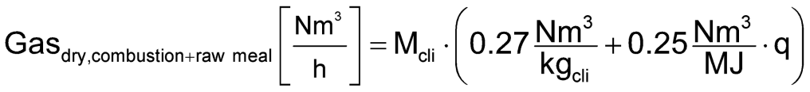
Dry exhaust gas from combustion and raw meal
Gasflow Calculations
H₂O
Kiln exhaust gas
H₂O_{vapor}
CO₂
V_{min,dry}
&
CO_{2,raw meal}
Fuel
V_{min,wet}
H₂O_{vapor}
V_{min,dry}
CO₂,SO₂,N₂
A_{min}
Excess air O₂,N₂
Excess Air
Air
False
air
M_{cli} = clinker production rate [kg_{cli}/h] q = spec. heat consumption [MJ/kg_{cli}]
CO_{2,raw meal}
V_{min,dry}
15

Slide 16

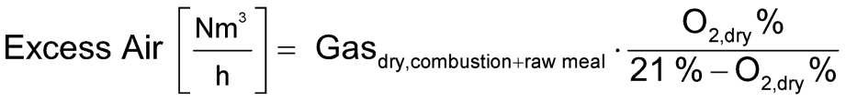
Excess air (including False air)
Gasflow Calculations
H₂O
Kiln exhaust gas
H₂O_{vapor}
CO₂
V_{min,dry}
&
CO_{2,raw meal}
Fuel
V_{min,wet}
H₂O_{vapor}
V_{min,dry}
CO₂,SO₂,N₂
A_{min}
Excess air O₂,N₂
Excess Air
Air
False
air
O_{2,dry} % = measured (dry) O₂ concentration
16

Slide 17
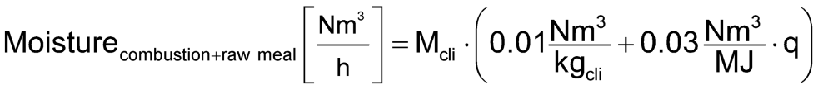
Moisture
Gasflow Calculations
H₂O
Kiln exhaust gas
H₂O_{vapor}
CO₂
V_{min,dry}
&
CO_{2,raw meal}
Fuel
V_{min,wet}
H₂O_{vapor}
V_{min,dry}
CO₂,SO₂,N₂
A_{min}
Excess air O₂,N₂
Excess Air
Air
False
air
M_{cli} = clinker production rate [kg_{cli}/h]
q = spec. heat consumption [MJ/kg_{cli}]
H₂O_{raw meal}
(V_{min,wet} - V_{min,dry})
17

Slide 18
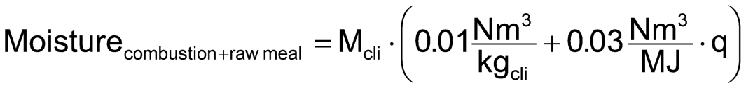
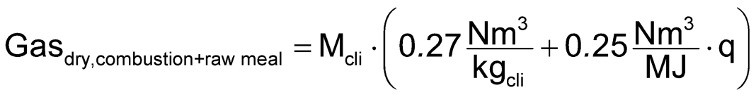
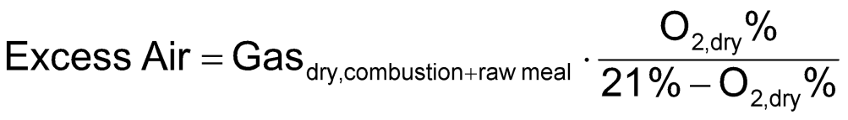
Total kiln exhaust gas
Gasflow Calculations
Kiln exhaust gas
H₂O_{vapor}
V_{min,dry}
&
CO_{2,raw meal}
Excess Air
from raw meal
from combustion
excess air (based on dry O₂ measurement)
18

Slide 19
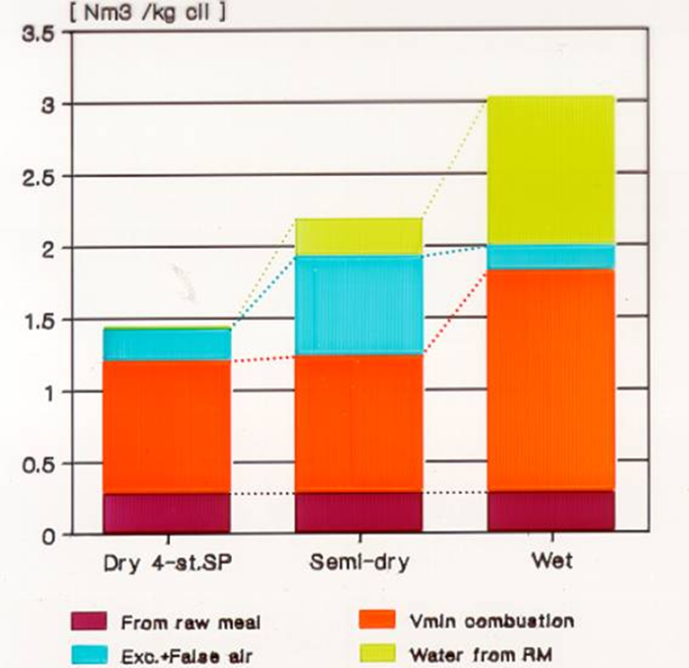
Typical exhaust gas quantities & compositions for different kiln systems
Gasflow Calculations
at kiln system outlet
19

Slide 20
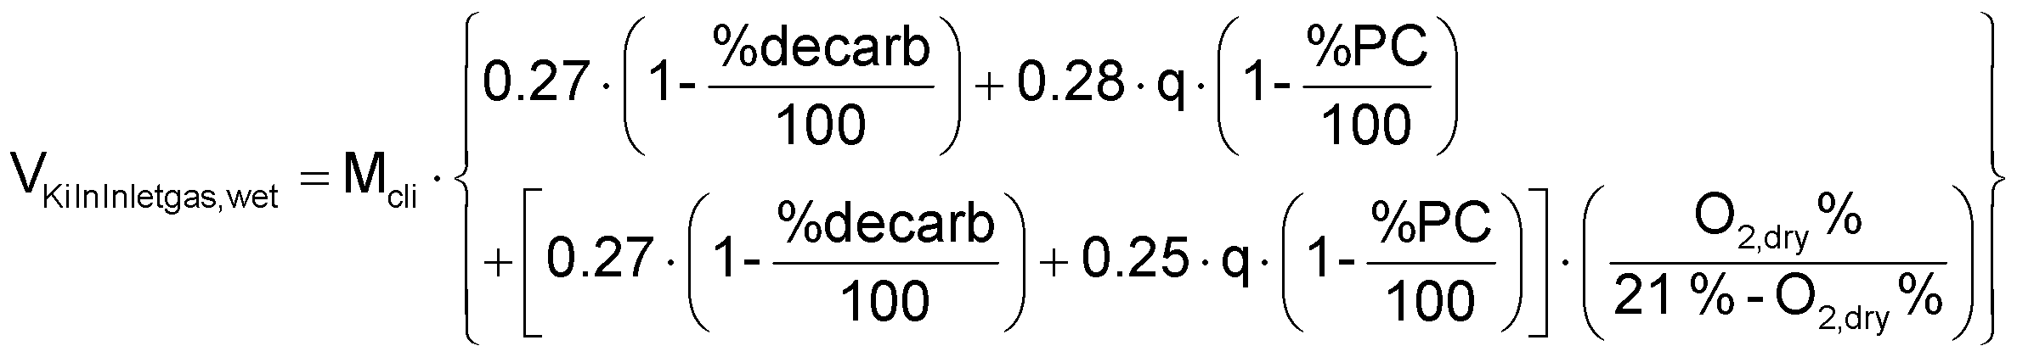
20

Slide 21
Content
Basic Definitions
Gasflow Calculations
False Air Investigation
21

Slide 22
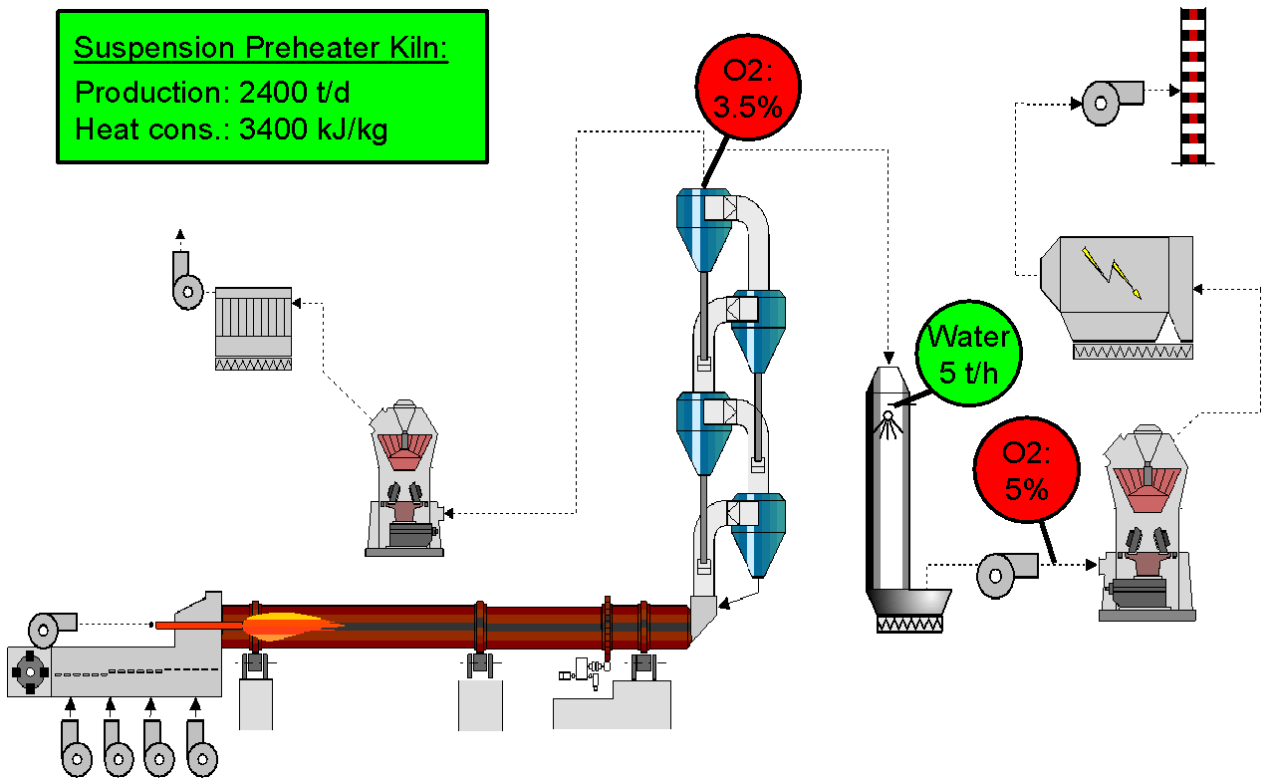
False air investigation
False Air Investigation
How much false air is entering into the kiln system between preheater exit and ID-Fan?
What is the total exhaust gas flow at the ID-Fan
22

Slide 23
Exhaust gas composition at PH exit and ID-fan
False Air Investigation
Preheater Exit
1
2
ID-Fan
CT
Water
H₂O_{vapor}
Kiln exhaust gas
H₂O_{vapor}
V_{min,dry}
&
CO_{2,raw meal}
V_{min,dry}
&
CO_{2,raw meal}
Excess air
E_{PHexit}
Excess air E_{ID-Fan}
False
False Air = E_{ID-Fan} – E_{PHexit}
air
23

Slide 24
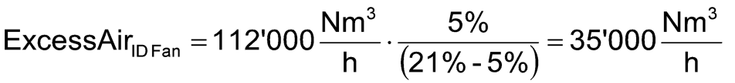
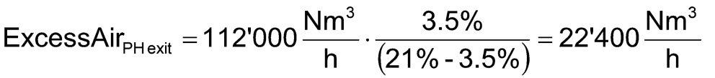
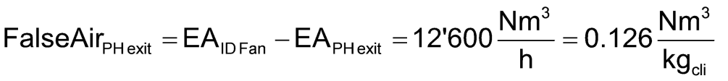
1) False air intake between PH exit and ID-fan
False Air Investigation
Dry exhaust gas flow at preheater exit
Excess air at ID-Fan
Excess air at preheater exit
False air intake between PH exit and ID fan
24

Slide 25
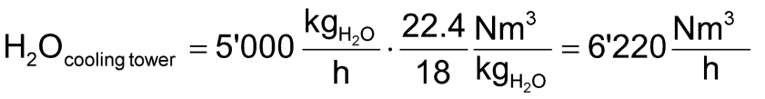

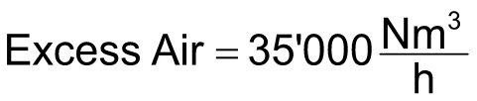
2) Total exhaust gas flow at ID-Fan
False Air Investigation
25

Slide 26
Summary
Fuel, raw meal & air contribute to total exhaust gas flow → additional inputs, e.g. water injection (cooling tower)
Total exhaust gas flow is calculated with
clinker production rate
specific heat consumption
O2 concentration
False air intake is determined by O₂ measurement at the different locations in the kiln system
26

Slide 27
Key messages
Any false air intake increases heat consumption, increases power consumption or reduces production capacity (if ID-fan limited)
Determine and reduce the amount of false air in your kiln system frequently
PPE/Combustion Engineering, 2013-11-072015-08-04
27
27

Slide 29
Additional Information
PPE/Combustion Engineering, 2013-11-072015-08-04
29
29

Slide 30

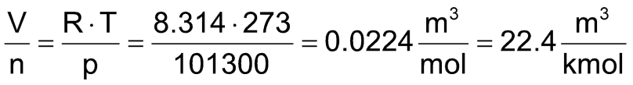

Molecules → mol → Nm³
Basic Definitions
atoms & molecules
1 kmol are 6.02 · 10²⁶ molecules
atom: e.g. C, H, O, N, S
molecule: group of atoms, → e.g. CO₂, N₂, O₂, H₂O, CH₄
=
=
=
=
Avogadro constant
Ideal gas law:
R: universal gas constant
R = 8.314 kJ/kmol/K
n: mole number [kmol]
At normal conditions 1 kmol of gas occupies 22.4 m³ of volume
1 kmol = 22.4 Nm³
PPE/Combustion Engineering, 2013-11-072015-08-04
30
30

Slide 31
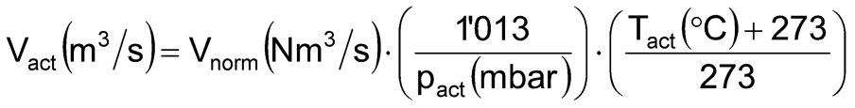

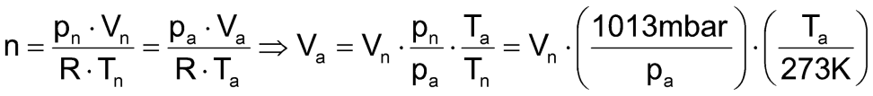
Gas flow conversion from Nm³ to actual conditions
Basic Definitions
The formula below is used to convert gas flows of ideal gases from normal conditions (0°C, 1’013 mbar) to actual conditions (T, p) in the process.
V_{act} gas flow at actual conditions in m³/s
V_{norm} gas flow at normal conditions in Nm³/s
T_{act} actual gas flow temperature in °C
p_{act} = p_{ambient} + p_{measured,relative} actual absolute pressure in mbar
Ideal gas law:
R: universal gas constant
R = 8.314 kJ/kmol/K
n: mole number [kmol]
ambient pressure
measured pressure difference
PPE/Combustion Engineering, 2013-11-072015-08-04
31
31

Slide 32
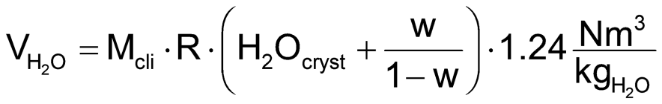
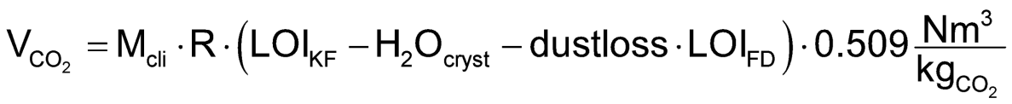
Gases from kiln feed/raw meal (detailed calculation)
Gasflow Calculations
For wet kilns and/or if kiln dust is extracted and discarded
H₂O from raw meal/slurry moisture
CO₂ from raw meal
M_{cli} clinker production rate (kg_{cli}/h)
R kiln feed to clinker ratio = 1/[(1-LOI_{KF})·(1-dustloss)] (kg_{KF}/kg_{cli})
H₂O_{cryst} % crystal water (chemically bonded water) (kg_{H2O}/kg_{KF})
w % moisture content of raw meal (kg_{H2O}/kg_{RM})
LOI_{KF} loss on ignition of kiln feed (kg_{LOI}/kg_{KF})
LOI_{FD} loss on ignition of filter dust (extracted kiln dust) (kg_{LOI}/kg_{FD})
dustloss % dust leaving kiln system (wet: smoke chamber, dry: PH exit) (kg_{FD}/kg_{KF})
PPE/Combustion Engineering, 2013-11-072015-08-04
32
32

Slide 33
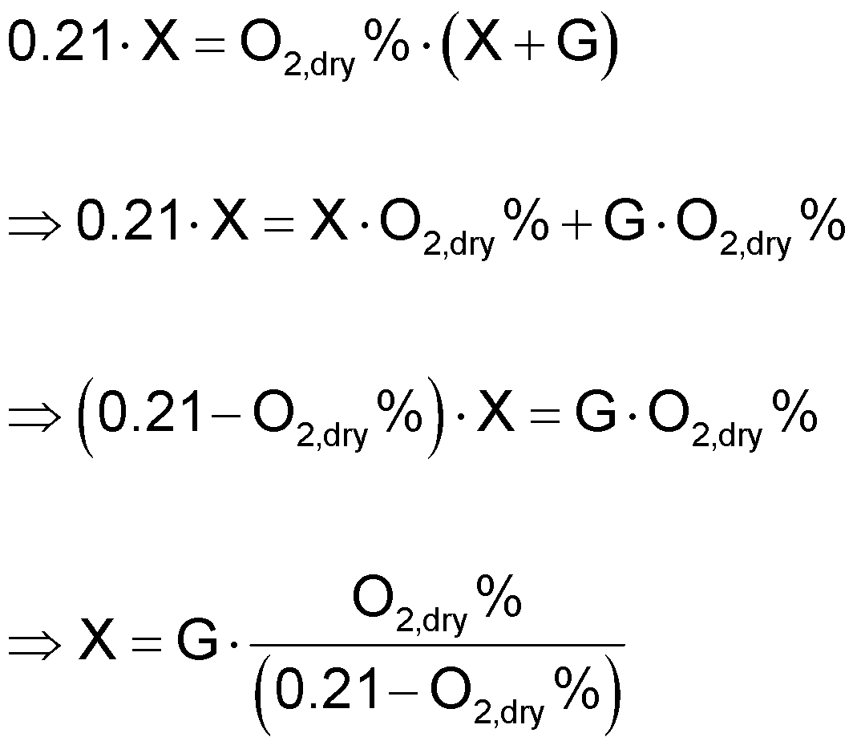
Excess air (including False air)
Gasflow Calculations
Kiln exhaust gas
H₂O_{vapor}
condensed before measurement
V_{min,dry}
&
CO_{2,raw meal}
G
Excess Air
79% N₂
X
21% O₂
O_{2,dry} %
O_{2,dry} % = measured O₂ concentration
PPE/Combustion Engineering, 2013-11-072015-08-04
33
33

Slide 34
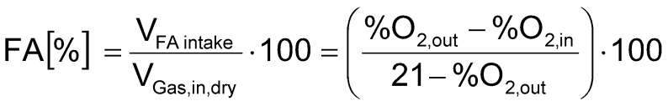
False air intake
Gasflow Calculations
FA [%] = additional false air as fraction of flow before false air intake
V_{FA intake} [Nm³/h] = false air intake
V_{Gas,in,dry} [Nm³/h] = gas flow (dry) before false air intake
%O_{2,in} [%] = measured O₂ concentration (dry) before intake
%O_{2,out} [%] = measured O₂ concentration (dry) after intake
Important! If it is not possible to measure the O₂ before and after the intake simultaneously, the two measurements have to be corrected for the O₂ variation in the gas flow, e.g. by comparison to the O₂ signal at PH exit.
PPE/Combustion Engineering, 2013-11-072015-08-04
34
34

Slide 35
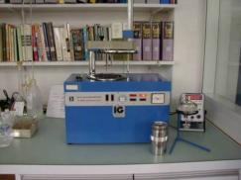
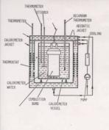
Gross & Net Calorific Values
Basic Definitions
Gross Calorific Value
CV_{gross} =
Heat of Combustion referred to 25°C
→ including condensation of H₂O
→ measured in bomb calorimeter
Bomb calorimeter
→ measurement of CV_{gross}
→ CV_{net} calculated with formula below
Net Calorific Value
CV_{net} =
CV_{gross} - H₂O_{combustion} ∙ 2450 kJ/kg_{H2O}
CV_{gross} - (H₂O_{fuel}+ 9 H) ∙ 2450 kJ/kg_{H2O}
PPE/Combustion Engineering, 2013-11-072015-08-04
35
35

